Slide 1
Designing with planar magnetics
Furkan Tokgöz

Slide 2
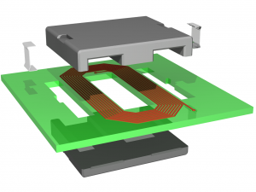
Planar Magnetics
Fig.1. Planar inductor

Slide 3
Advantages
Low profile
Better thermal characteristics
Easy manufacturing
Constant parasitics

Slide 4
Disadvantages
Greater footprint
High parasitic capacitance
Low number of turns

Slide 5
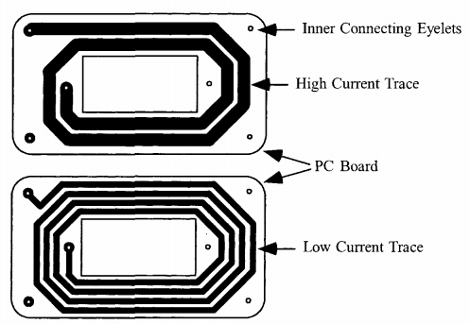
Winding
Fig.2. E core winding [2]

Slide 6
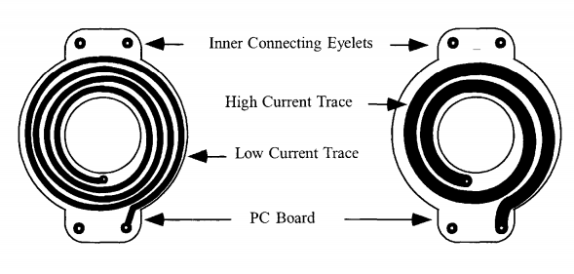
Winding
Fig.3. R core winding [2]

Slide 7
Parameters
L= 0.8 mH
I= 4 A
J= 400 A/cm^2
f=50 kHz
ΔT=50 C

Slide 8
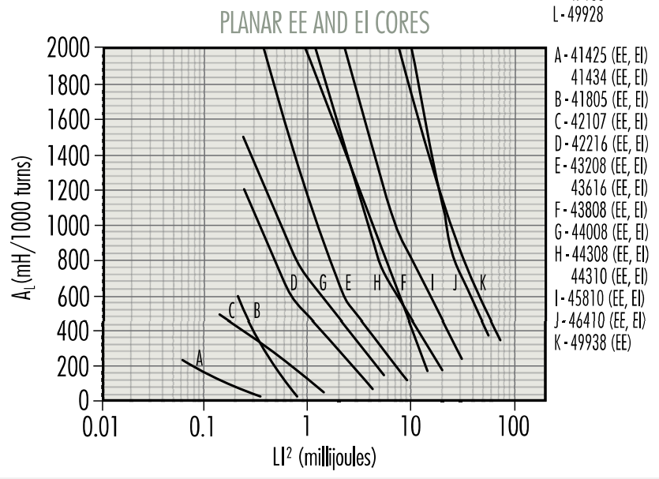
Design
LI^2=12.8 mJ
Fig.4. Inductance factor vs energy graph [1]

Slide 9

Design
$N=1000\sqrt{\frac{L}{A_{L}}}$ = 36 turns
Skin depth= 0.292mm
Width=0.6 mm

Slide 10
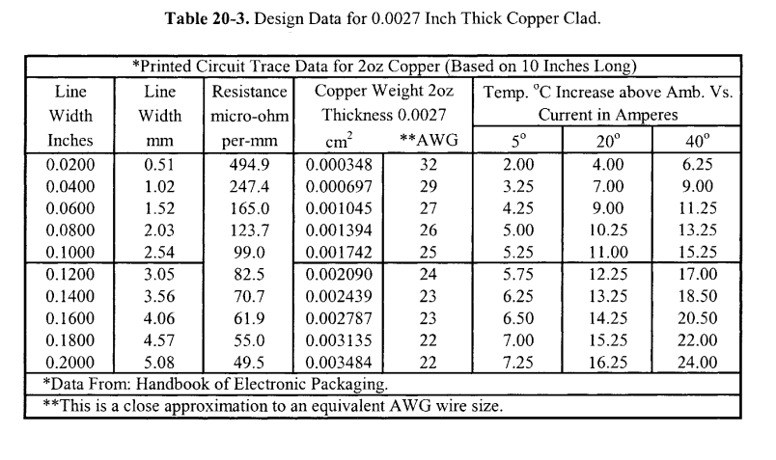
Design
Fig.5. Copper winding table [2]

Slide 11
Design
J= 4/0.000697 = 5739 A/cm^2 (!)

Slide 12
Inductor design ferrite cores,Magnetics Inc
Transformer and Inductor Design Handbook Chapter 20, McLyman

